Slide 1
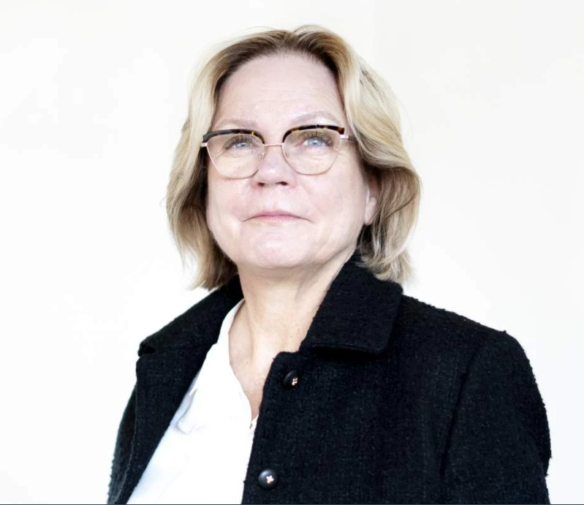
Interim CFO
Karin Djärf, CFO of the Division, has decided to pursue her career outside of AFRY after 10 years.
Karin Skoglund is very experienced within international companies and is a certified board member and investor.
She will join the Division as acting CFO as of April 1, and work alongside Karin Djärf to assure a qualitative continuation of support for the division during April and Q1 reporting.

